Slide 1
BFSI - Case Study
Cohort 12
Palak Gupta
Ravi Kumar

Slide 2
CredX is a leading company which aims for acquiring right customers to mitigate credit risk and credit loss.
In past years, this company has observed credit loss by acquiring such customers who could be a defaulter in doing repayment, hence are aiming for choosing right set of customers to prevent credit loss.
In this case study; using the customer’s past demographic and Credit Bureau details, we have to identify the selection of rightful customers to prevent credit loss in CredX company.
Objective

Slide 3
Selection of rightful customers are to be predicted using Machine learning models which has to be created on Demographic data and demographic and Credit bureau combined.
After selection of approved and rejected customers; an application scorecard has to be created to compare.
Two files: Demographic and Credit Bureau details are used for this
Before creating models using these details; Data cleanup was done on Demographic details:
Around 2% of entire demographic details was removed because of missing value, before performing logistics regression
Model1: Only with Demographic details
Performed EDA on it
Converted categorical fields into dummy variables (Gender, Marital Status (at the time of application), Education, Profession & Type of residence)
Used RFE to identify valuable setoff fields from demographic details
Performed LR on it with these variables
Selected final set of variables with correct VIF and P values
Final set of variables are: 'Income', 'No of months in current company', 'Profession _SE‘
Cut off value is observed as: 0.5
Approach

Slide 4
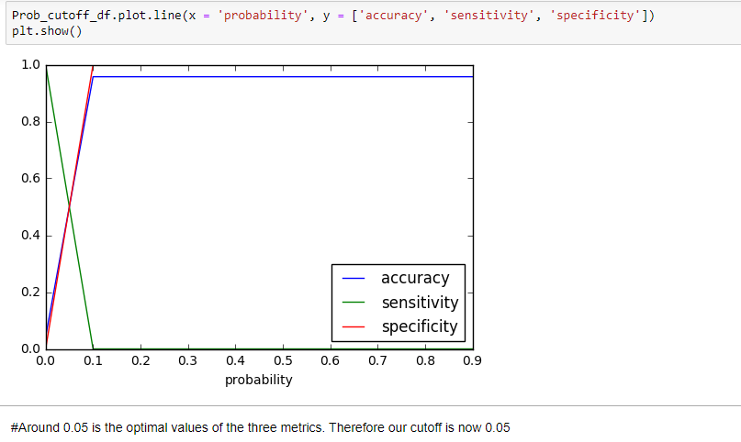
Accuracy: 0.95
Sensitivity: 0.30
Specificity: 0.77
Approach

Slide 5
Model 2: With Demographic and Credit Bureau details
Master Dataframe is created combining both demographic and Credit Bureau details.
Removed records with missing target variable (performance tag)
For the remaining fields; there were couple of fields where some data was misising
Imputation of such records were done using WOE and IV method
The most significant variables from the combined demographic and credit data are Avgas CC Utilization in last 12 month, No of trades opened in last 12 months, Outstanding Balance, No of PLtrades opened in last 12 months, Total No of Trades
We choose two model to select optimum one
LR model using below fields (derived from RFE):
Gender', 'Marital Status (at the time of application)',
'No of dependents', 'Education', 'Profession ', 'Type of residence',
'No of times 90 DPD or worse in last 6 months',
'No of times 60 DPD or worse in last 6 months',
'No of times 30 DPD or worse in last 6 months',
'No of times 60 DPD or worse in last 12 months',
'No of times 30 DPD or worse in last 12 months',
'Avgas CC Utilization in last 12 months',
'No of trades opened in last 12 months',
'No of Inquiries in last 12 months (excluding home & auto loans)',
'Presence of open home loan
Approach

Slide 6
After performing LR on it and calculating VIF factor and P values; final set of fields are as below:
No of trades opened in last 12 months
Avgas CC Utilization in last 12 months
No of Inquiries in last 12 months (excluding home & auto loans)
No of times 30 DPD or worse in last 12 months
No of dependents
Education
Profession
Another model was used as Random forest with multiple validation criteria.
After performing above steps; it is evaluated as below:
Accuracy : 0.5548325358851675
Precision : 0.06446961894953657
Recall : 0.7399527186761229
Later: we calculated application scorecard for approved and rejected applicants
Approach

